Slide 1
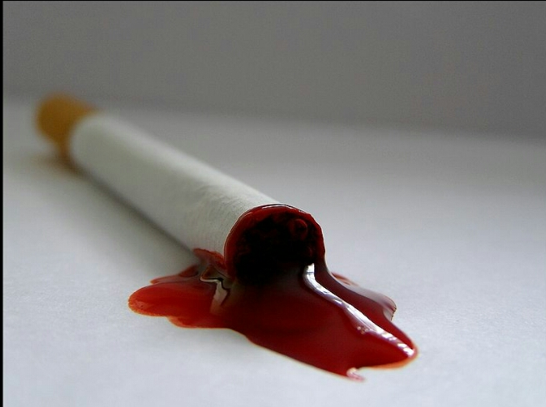
TOBACCO AND OTHER HARMFUL HABITS AND ITS EFFECT ON ORAL CAVITY

Slide 2
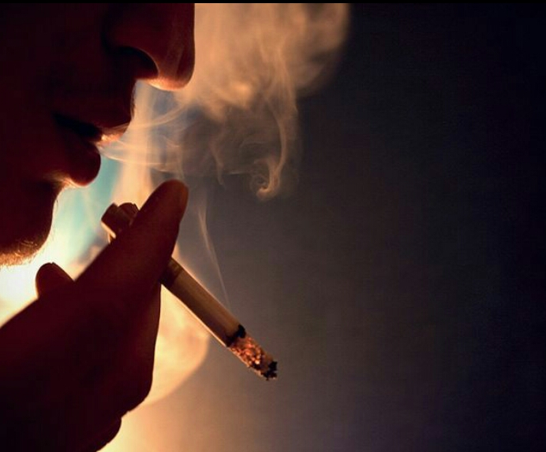
“STOP SMOKING!
IT WEAKENS YOU , IT RUINS YOU”

Slide 3
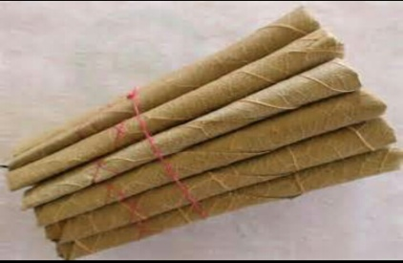

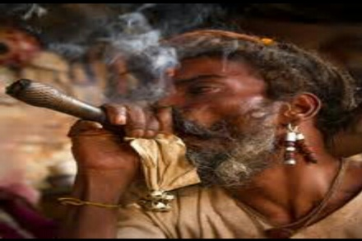
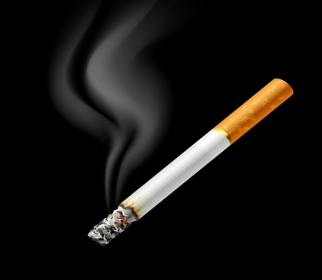
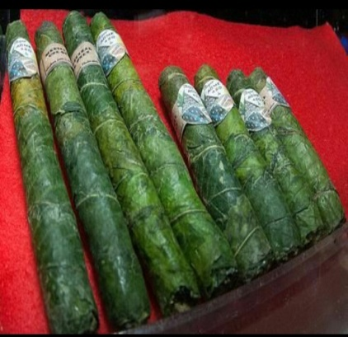
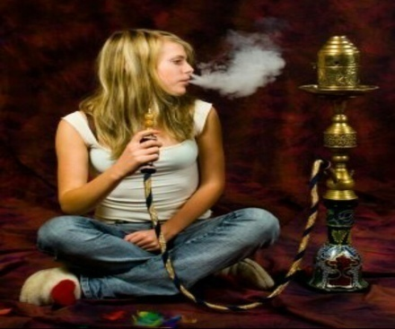
VARIOUS FORMS OF TOBACCO
SMOKED TOBACCO
BIDI
CHUTTA
CHILLUM
CIGARETTE
DHUMTI
HOOKAH

Slide 4

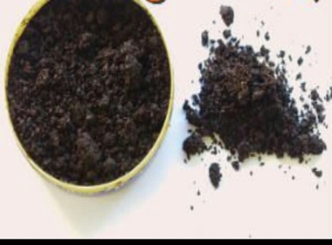
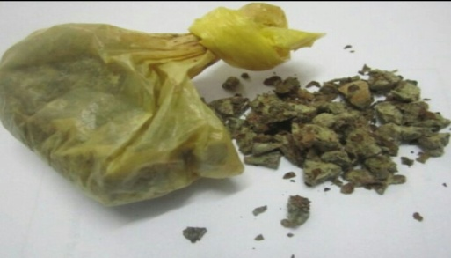
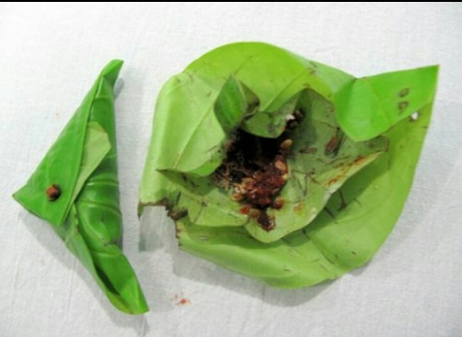
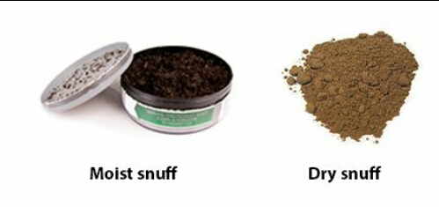
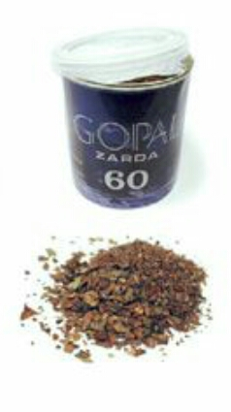
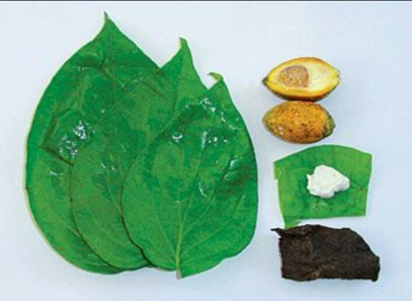
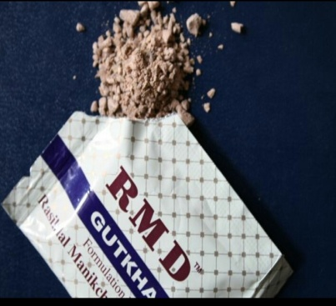
SMOKELESS TOBACCO
KHAINI
MAWA
MAINPURI TOBACCO
PAAN
SNUFF
ZARDA
PAAN MASALA
GUTKA

Slide 5
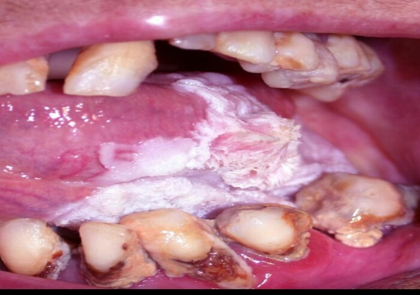
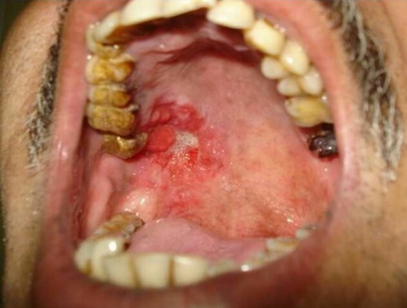
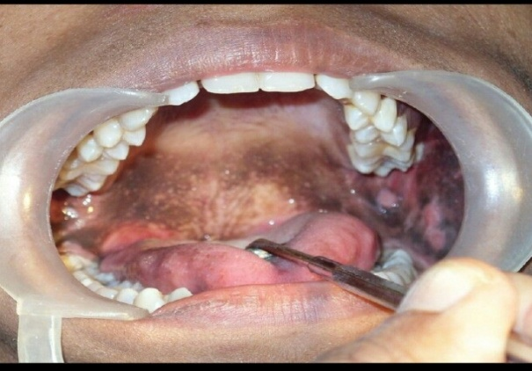
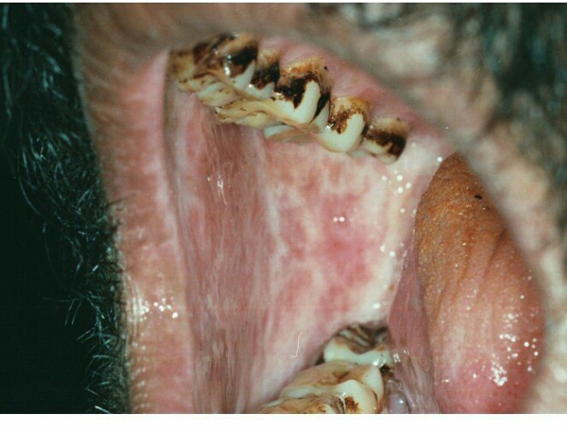
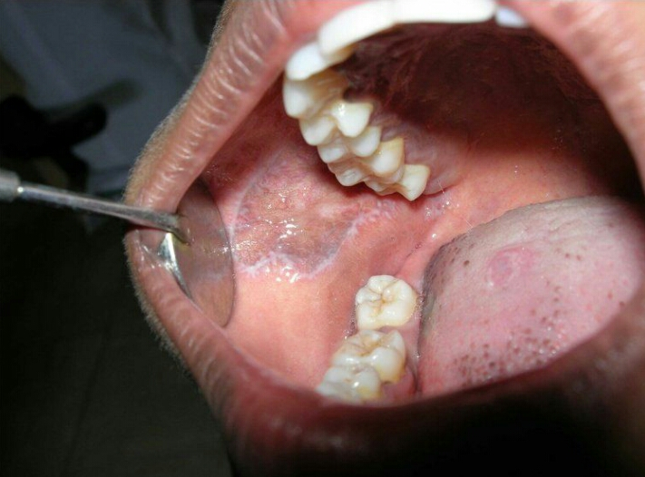
EFFECTS ON ORAL CAVITY
LEUKOPLAKIA
ERYTHROPLAKIA
SMOKER’S PALATE
LICHEN PLANUS
ORAL SUBMUCOUS FIBROSIS

Slide 6
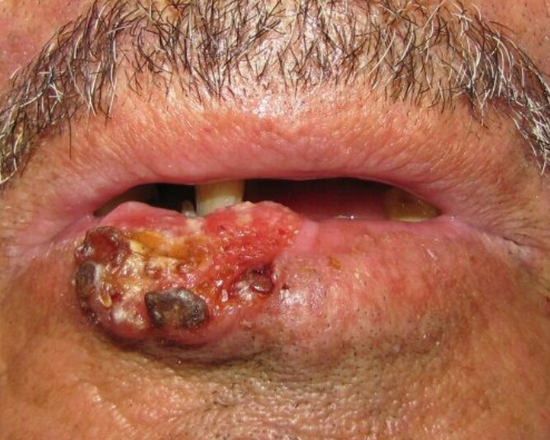
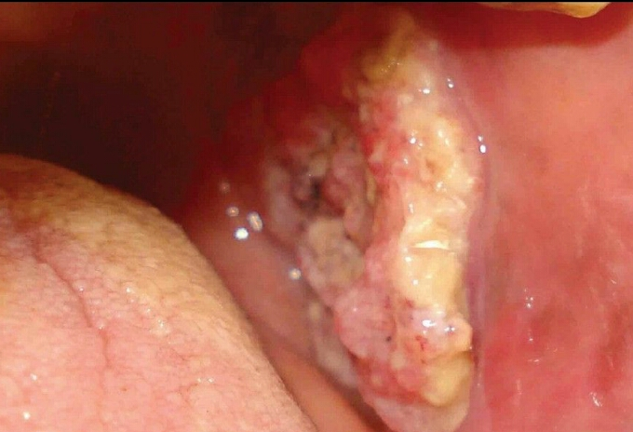
ORAL CANCER
CARCINOMA OF LIP
CARCINOMA OF BUCCAL MUCOSA

Slide 7
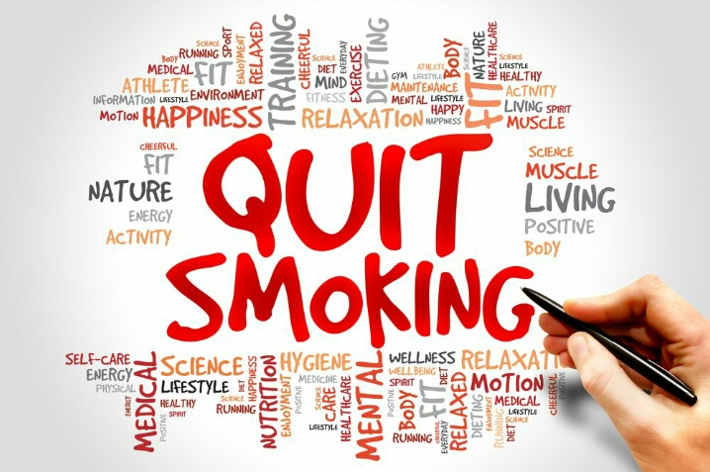

Slide 8
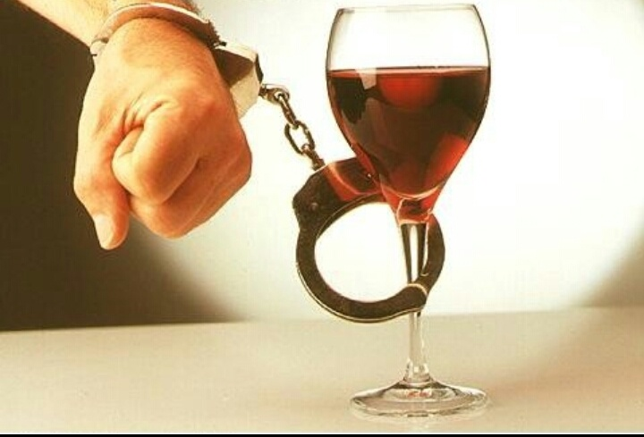
ALCOHOL
CONSUMPTION

Slide 9
HEAVY DRINKING CAN CAUSE:
Increase tooth decay
Increase risk of periodontal diseases
Poor healing after dental surgery
Irritation of gum , tongue and oral tissues
Increased risk of oral cancer

Slide 10


Slide 11

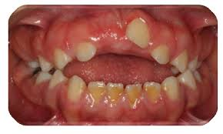
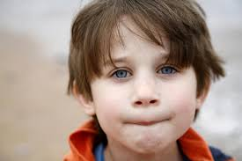
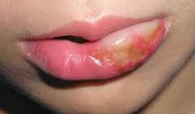

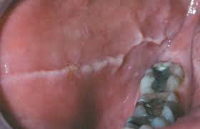
ADVERSE ORAL HABITS

Slide 12
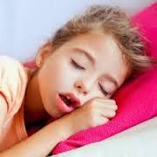
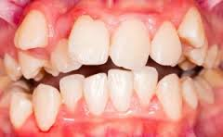
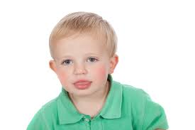
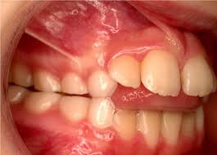
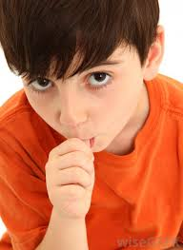
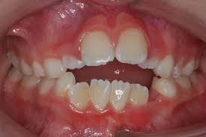
ADVERSE ORAL HABITS

Slide 13

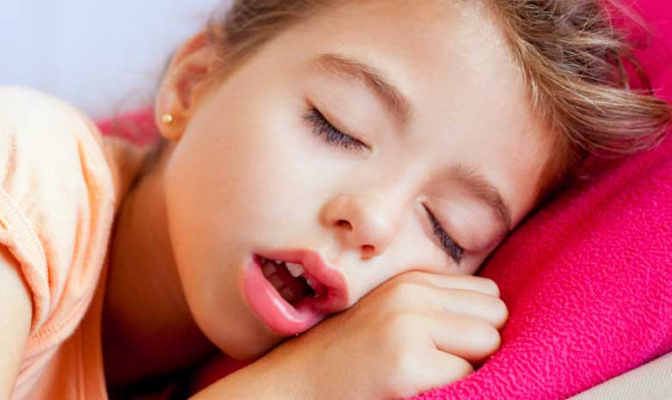
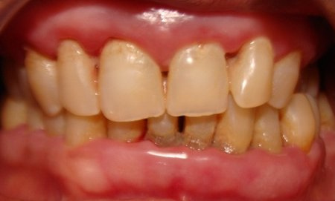
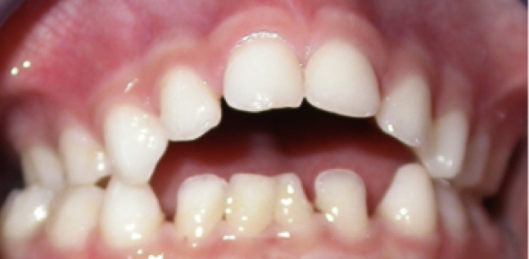
MOUTH BREATHING
Breathing through the mouth rather than the nose.
Effects

Slide 14

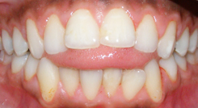
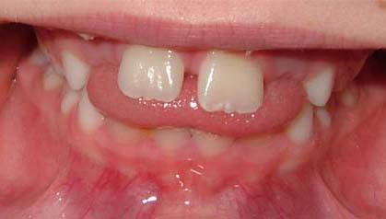
TONGUE THRUSTING
The thrusting of the tongue against or between the incisors during the act of swallowing

